Slide 1

Bhavas Classification using Deep Learning
June 3, 2021
Thursday
CSE Department, JECC
Notes:
1
1
1
1
1

Slide 2
Group No: 24
Group Members :
Nova Dileep JEC17CS078
Shinoz Mohammed P P JEC17CS094
Sreelakshmi C (Team Leader) JEC17CS098
Name of mentor:
Ms. Reshma K V
Assistant Professor
CSE Department, JECC
Notes:
2

Slide 3
Vision of the Department
Creating eminent and ethical leaders in the domain of Computational Sciences through quality professional education with a focus on holistic learning and excellence.
Mission of the Department
To create technically competent and ethically conscious graduates in the field of Computer Science and Engineering by encouraging holistic learning and excellence.
To prepare students for careers in Industry, Academia and the Government.
To instill Entrepreneurial Orientation and research motivation among the students of the department.
To emerge as a leader in education in the region by encouraging teaching, learning, industry and societal connect.
CSE Department, JECC
Notes:
3

Slide 4
Contents
Introduction
Problem Statement
Existing System
Literature Survey
Proposed System
Implementation
Conclusion
Publication
Future Scope
Reference
CSE Department, JECC
Notes:
4
4
4
4
4

Slide 5
Introduction
Facial expressions are important factors in human communication that helps us to understand feelings and intensions of others
It is one of the major significant features of recognition of human emotion
Use the facial recognition techniques to identify different ‘Bhavas’ in the dance form
CSE Department, JECC

Slide 6
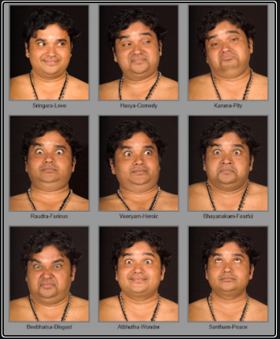
CSE Department, JECC

Slide 7
Sringara : Happy
Hasya : Comic
Karuna : Compassion
Roudra : Anger
Veera : Valor
Bhayankara : Fear
Bheebhatsya : Disgust
Adbhutha : Wonder
Shanta : Tranquility
CSE Department, JECC

Slide 8
Bhavas classification is used to classify the ‘navarasam’ of classical dance
Easily understands the meaning of each bhavas
CSE Department, JECC

Slide 9
Problem Statement
Non trained dancers can’t understand meaning of navarasams(bhavas) in classical dances
Can’t enjoy the dance performances in it’s full extent
Existing system classifies only human emotions and not bhavas
This system identifies and classifies bhavas and therefore is a better option
CSE Department, JECC

Slide 10
Existing system
Convolutional Neural Network(CNN) is used to identify 6 elementary emotions
i.Happy
ii.Sad
iii.Fear
iv.Anger
v.Surprise
vi.Disgust
CSE Department, JECC

Slide 11
2.Classification is done through simple image processing
3.Different types of layers are present
i.Input layer
ii.Convolution layer
iii.Activation layer
iv.Pooling layer
a.Mean pooling
b.Max pooling
v. Fully connected layer
vi.Softmax layer
4. Accuracy of 91.6 % has been achieved by the test result
CSE Department, JECC

Slide 12
Advantages & Disadvantages
1.Advantages
i.High accuracy
ii.Automatic extraction of features
2.Disadvantages
i.Classifies input images to atmost 5 facial expressions
ii.Less accuracy for disgust and surprise expressions
CSE Department, JECC

Slide 13
Literature Survey
Sl.No | Objective | Dataset | Methodology | Conclusion | Contribution to our project | Disadvantage
1 | 1.Convolutional Neural Network (CNN) 2. Identify 6 basic emotions 3.Implemented in MATLAB | JAFFE (Japanese Female Facial Expression ) | 1.Take the input image 2.Image is pass through CNN 3.Feature extraction and Classification is performed 4.Accuracy | 1. complete view of facial emotion recognition system. 2.An accuracy of 91.6 % has been achieved by the test result. | 1.Gives a complete view of facial emotion recognition system 2.CNN algorithm can be used for the project | 1. Classifies input images to atmost 7 facial expressions 2. less accuracy for disgust and surprised expressions
CSE Department, JECC
Notes:
13
13
13
13
13

Slide 14
2. | 1.Detect people’s emotions in natural conditions 2.outperform traditional approaches 3.Human-level performance 4..Convolutional Neural Network (CNN) | FER-2013 | 1.Take the input image 2.Image is passed through a)Baseline model b)Five layer model c)ResNet50 model d)ED NET 3.Feature extraction and Classification is performed 4.Accuracy calculation | 1.Accuracies of some of the models achieved on the FER2013 test data a)Human_level - 65±5% b) Yichuan Tan- 71.2% c) Shervin Minaee-70.02% d) Baseline -61% e) Five-layer model -66.2% f) ResNet50 - 73% g) ED NET - 73.9% h) State_of_the_art - 76.8% | 1. CNN algorithm can be used for the project | 1. Only 7 facial expression 2. More time is required
CSE Department, JECC
Notes:
14
14
14
14
14

Slide 15
3. | 1.To improve the accuracy in classifying emotions 2. To classify the facial expressions to angry, happy, fear, neutral, sad and surprise using CNN architecture | Combination of CK+, RaFD, MUG, KDEF | 1.Take the input image 2.Fine tuning CNN architecture by VGG 3.Fine tuning CNN architecture by first model 4.Accuracy calculation | 1.Accuracies obtained on different datasets: a)CK+ - 99.33% b)MUG – 87.65% c)RaFD – 93.33% 2.Highest accuracy is obtained for CK+ | 1. CNN algorithm can be used for the project | Considered images which has face in one position only
CSE Department, JECC
Notes:
15
15
15
15
15

Slide 16
4. | 1. To avoid the explicit feature extraction process 2. To Classify facial expressions to worried, angry, disgust, surprise, anxious, happy, sad, neutral emotions | CLDC | 1.Image is normalized 2.Features are extracted and dimension is reduced using convolution layers and max pooling 3.RPN is used for region proposal 4.Softmax and regressor for classification and predicting bounding box coordinates | 1.mean Average Precision obtained on different networks: a)VGG_CNN_M _1024 – 0.8200 b)ZF – 0.8203 c)VGG16 – 0.8312 2. Not very good identification for surprise and neutral | 1.Normalization technique can be used for preprocessing | Recognition rate for surprise and neutral is less
CSE Department, JECC
Notes:
16
16
16
16
16

Slide 17
5. | 1. To Classify facial expressions into 6 emotions. 2.Classifications with and without pre-processing of images. 3. Angry, sad, happy, disgust, surprise, fear and neutral. | FER-2013 | 1.Image pre-processing 2.Feature extraction and Classification using CNN. 6 Convolutional layers used. 3.Training set 4.Accuracy | 1.Obtained a test accuracy of 61.7% on FER2013 in a seven-classes classification task. | 1.CNN algorithm can be used in our project | Misclassified images came from the emotions of fear and sad with 43.95% and 49.77% accuracy
CSE Department, JECC
Notes:
17
17
17
17
17

Slide 18
6. | 1. Classify facial images into 6 emotions using CNN architecture. 2. using dataset FER2013 for training. | FER-2013 | 1.Face detection and pre-processing 2.Feature extraction using trainable convolution kernels. 3.Max pooling by pooling layer 4.Classification by softmax layer into the 6 basic classification | 1. An accuracy of 65.1 % has been achieved by the test result by CNN. 2. CNN architecture and CNN parameter training explained. | 1.CNN architecture can be used in our project | Distortion of image is high
CSE Department, JECC
Notes:
18
18
18
18
18

Slide 19
SRS
Functional Requirement | Non Functional Requirement
The system should classify an image into one of 5 emotions | The system should be implemented in Google Colaboratory
The system should include an automatic face expression detection algorithm
CSE Department, JECC

Slide 20
Architecture
Dataset
Image Preprocessing
Data Reformatting
Input Image
Feature Extraction
Augmentation
Normalization
CNN Algorithm
Facial Expression Classification
Corresponding Bhavas

Slide 21
DFD
Level -0
Facial Expression Detection
Input image
Bhavas
CSE Department, JECC

Slide 22
Level -1
Feature extraction(lip,
eyes and eyebrows)
Input image
Facial expression classification
Dataset
Bhavas
CSE Department, JECC

Slide 23
Proposed System
Dataset Creation -
A dataset created with 5 subfolders that includes 4 bhavas - ‘Bhayanakam’, ‘Bheebhalsam’, ‘Karunam’ & ‘Veeram’
Also another folder named ‘Others’ that contains the images of the remaining 5 bhavas
There are a total of 4664 augmented images in the dataset:
Bhayanakam - 720
Bheebhalsam - 620
Karunam - 580
Veeram - 778
Others - 1966
CSE Department, JECC

Slide 24
Image preprocessing-
Transforms the raw sourced data into a format that enables successful model training
Steps involved in preprocessing modules are -
Image reformatting
Feature Extraction
Augmentation
Normalization
In image reformatting, all images in the dataset are rescaled in to a fixed size of 150x150
The extraction of facial features requires translating the input data into a set of features
Features included in this project are - eyes, lips and eyebrows
CSE Department, JECC

Slide 25
f. The training masks are generated by detecting and localizing facial landmarks on a face image
g. In augmentation, images are flipped, rotated, sheared, zoomed which helps to increase number of images
h. Normalization involves normalizing data per pixel
Classification
Pretrained model EfficientNetB5 is used
5 dense layers are used
Softmax layer is used for classification
Classify image to bhavas
CSE Department, JECC

Slide 26
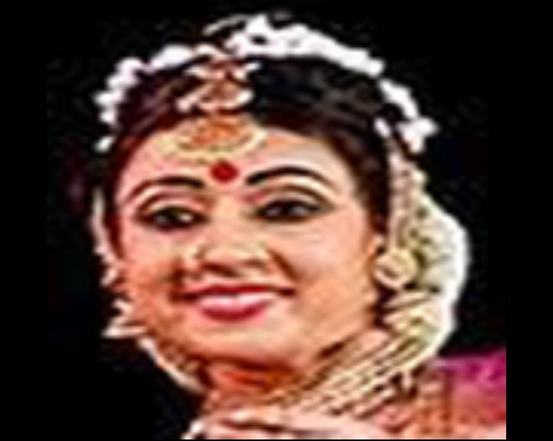

Implementation
1 .Resizing images
CSE Department, JECC

Slide 27
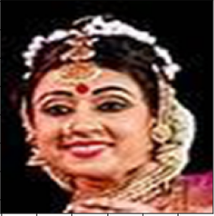
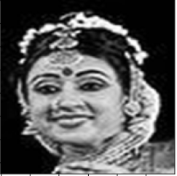
2.Converting RGB image to grayscale
CSE Department, JECC

Slide 28
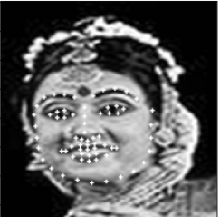
3.Landmark detection
CSE Department, JECC

Slide 29

4.Segmentation
CSE Department, JECC

Slide 30



5.Augmentation
CSE Department, JECC
CSE Department, JECC

Slide 31
6. Model creation
Pre-trained ‘EfficientNetB5’ model is used
On top of it, dense layers with ‘Relu’ activation functions are used
Total of 582 layers are used
576 layers of EfficientNetB5
5 dense layers
1 softmax layer
CSE Department, JECC

Slide 32
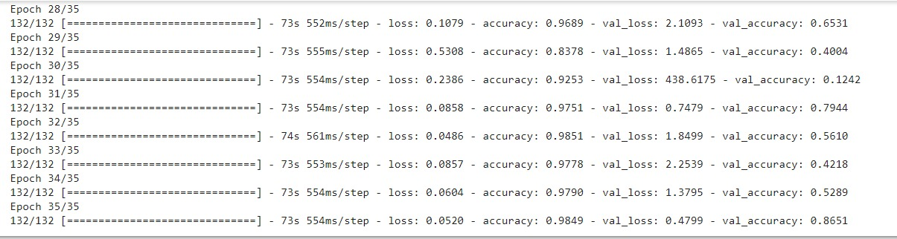

7. Training and Testing
CSE Department, JECC

Slide 33
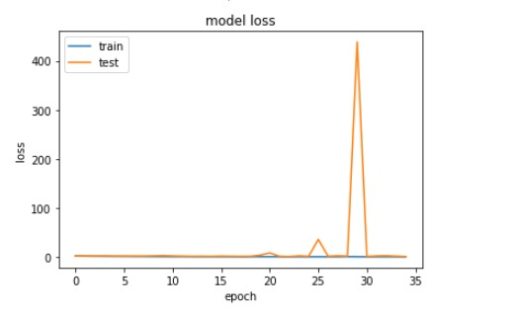
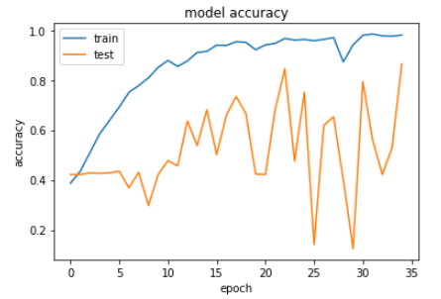
Accuracy and Loss

Slide 34
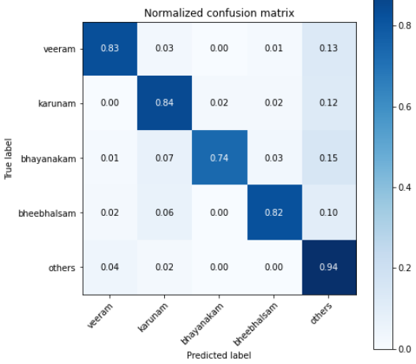
8. Confusion Matrix
CSE Department, JECC

Slide 35
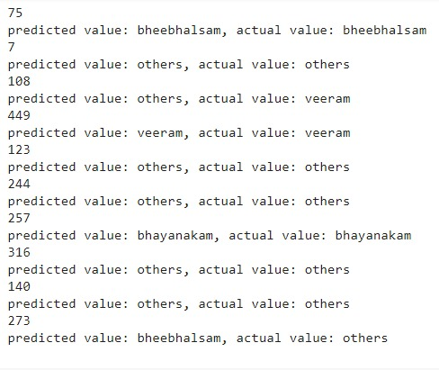
9. Model Prediction
CSE Department, JECC

Slide 36
Conclusion
This project helps to identify each bhavas with the help of modern technology
Classifies additional human facial expressions compared to existing systems
Preliminary tests achieved 86.5% bhavas recognition accuracy
CSE Department, JECC

Slide 37
Publication
Paper Title:Review of Facial Expression Detection using Deep Learning.
Link:https://www.ijert.org/research/review-of-facial-expression-detection-using-deep-learning-IJERTV10IS040305.pdf
CSE Department, JECC

Slide 38
Future Scope
To predict the remaining 5 bhavas - ‘Sringara’, ‘Hasya’, ‘Raudra’, ‘Adbhuta’ and ‘Shanta’
To predict bhavas of images from classical dance related videos
CSE Department, JECC

Slide 39
Reference
1.S. Harshitha, N. Sangeetha, A. P. Shirly and C. D. Abraham, "Human facial expression recognition using deep learning technique," 2019 2nd International Conference on Signal Processing and Communication (ICSPC), Coimbatore, India, 2019, pp. 339-342, doi: 10.1109/ICSPC46172.2019.8976876.
Vamshi. N, R. and Raja S, B., “Facial Expression Recognition using Deep
Learning”, <i>arXiv e-prints</i>, 2020.
Y. Lv, Z. Feng and C. Xu, "Facial expression recognition via deep learning," 2014 International Conference on Smart Computing, Hong Kong, 2014, pp. 303-308, doi: 10.1109/SMARTCOMP.2014.7043872
CSE Department, JECC

Slide 40
Jiaxing Li, Dexiang Zhang, Jingjing Zhang, Jun Zhang, Teng Li, Yi Xia, Qing Yan, Lina Xun,Facial Expression Recognition with Faster R-CNN,Procedia Computer Science,https://doi.org/10.1016/j.procs.2017.03.069.
.S. Singh and F. Nasoz, "Facial Expression Recognition with Convolutional Neural Networks," 2020 10th Annual Computing and Communication Workshop and Conference (CCWC), Las Vegas, NV, USA, 2020, pp. 0324-0328, doi: 10.1109/CCWC47524.2020.9031283.
.L. Xu, M. Fei, W. Zhou and A. Yang, "Face Expression Recognition Based on Convolutional Neural Network*," 2018 Australian & New Zealand Control Conference (ANZCC), Melbourne, VIC, 2018, pp. 115-118, doi: 10.1109/ANZCC.2018.8606597.
CSE Department, JECC

Slide 41
Thank You
CSE Department, JECC
Notes:
41

